Slide 1
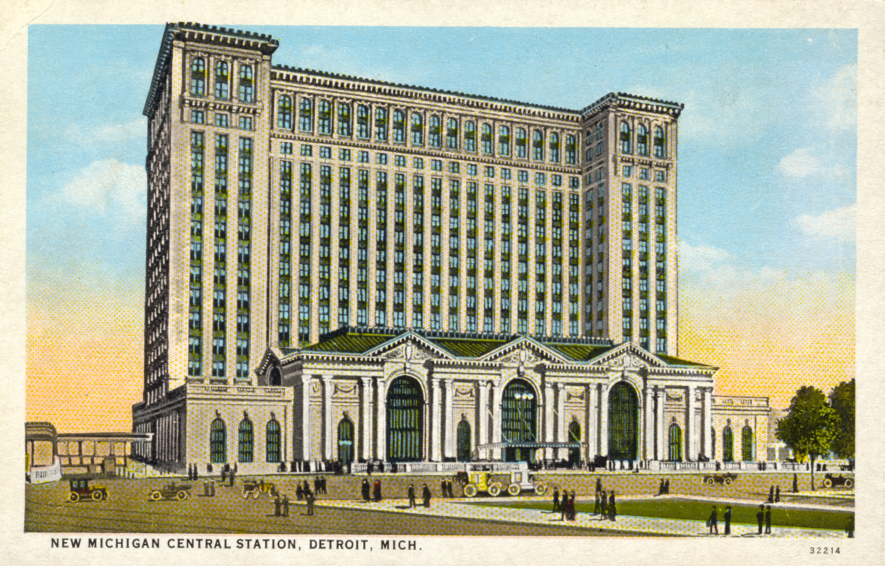
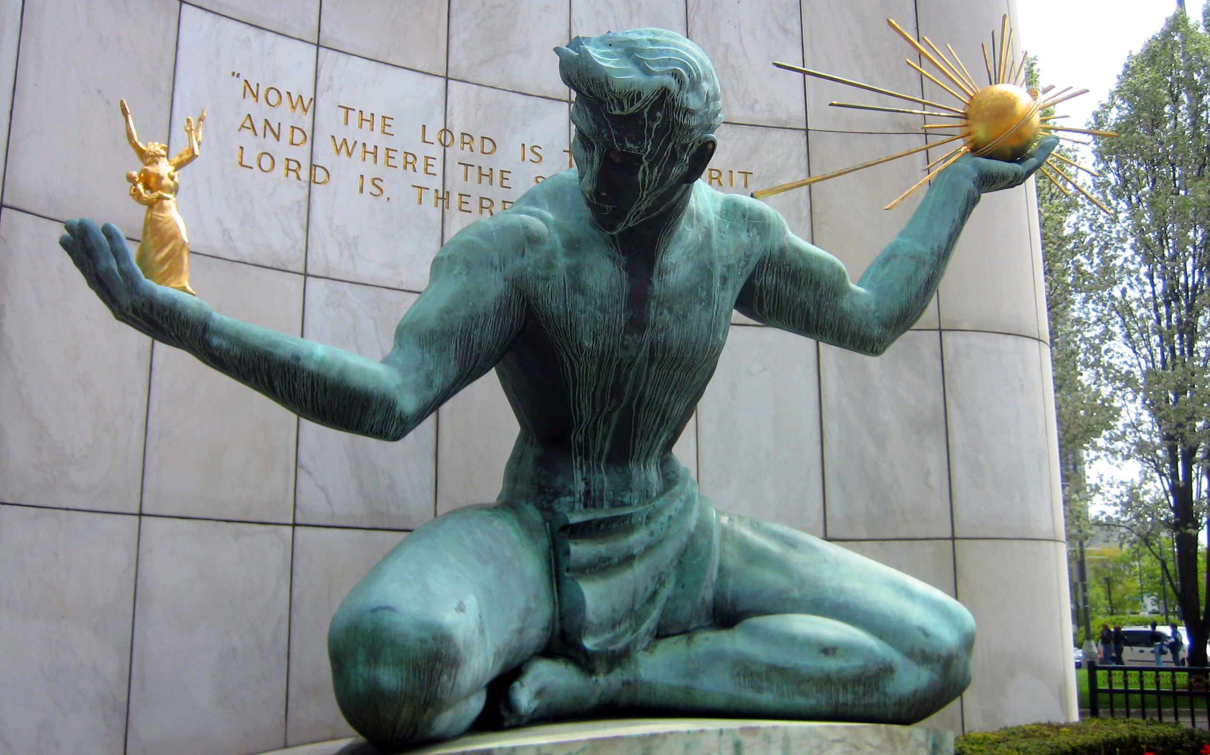
Understanding the Investment Landscape in Detroit Using Foursquare Data
Coursera Capstone Project
Chris Olson

Slide 2
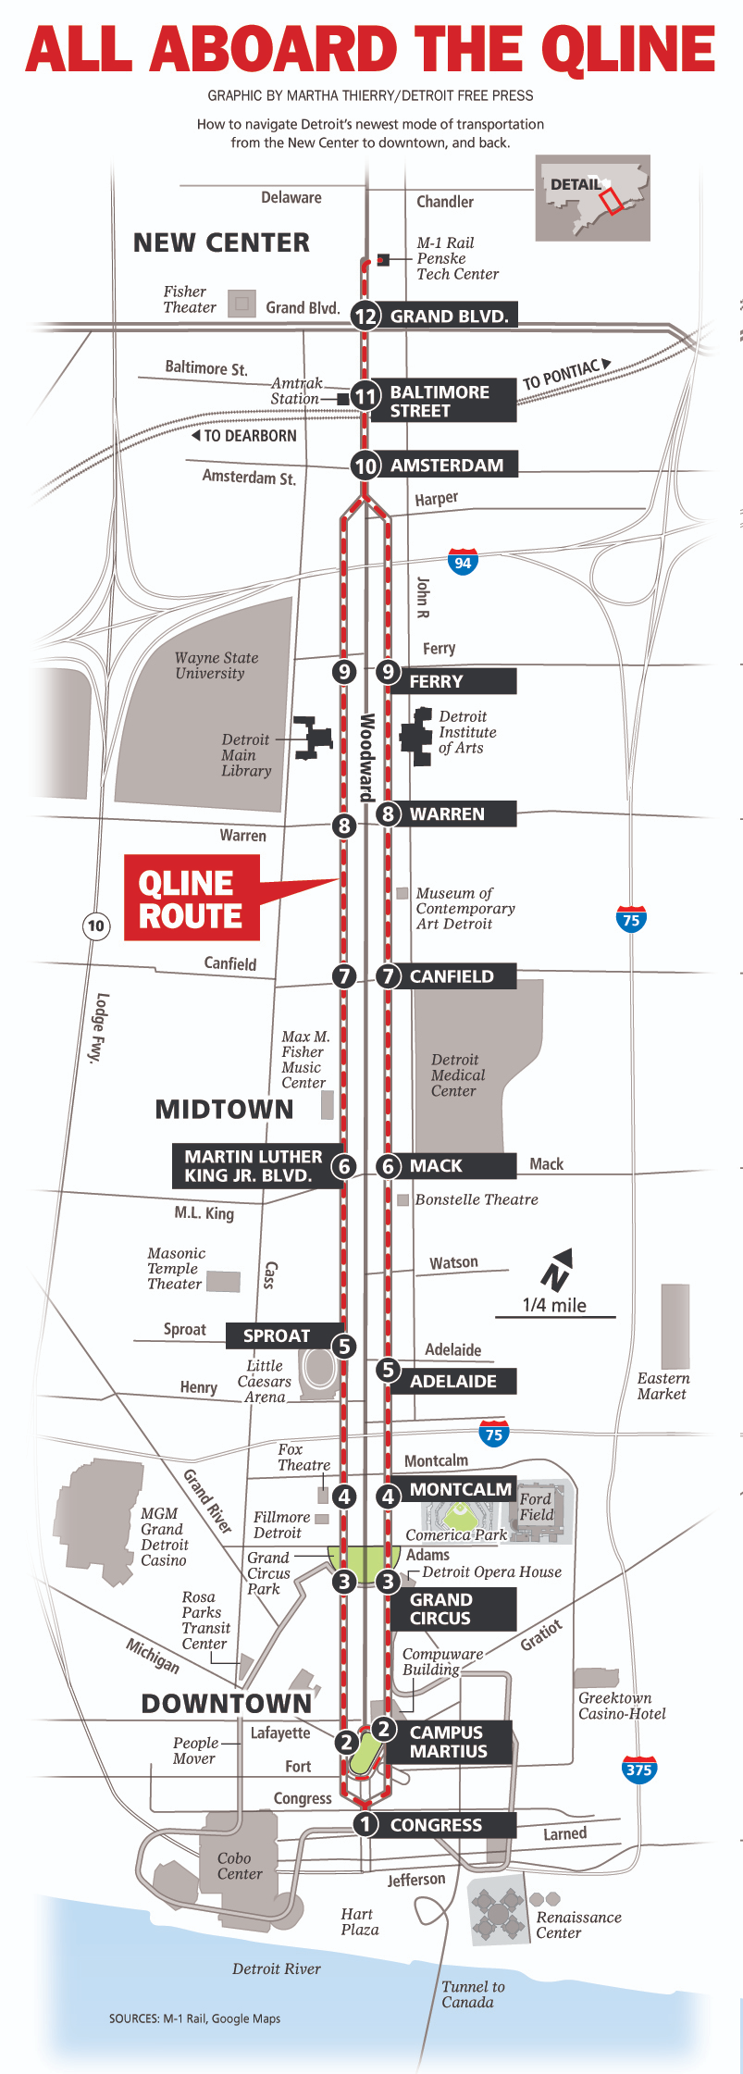
Recent Investment in Detroit
Little Caesars Arena opened in 2017
Q Line opened in 2017
Ford Motor Company purchases Michigan Central Station in 2018, renovations ongoing
Most investments are concentrated in certain neighborhoods in the city

Slide 3
Overview of the Data
Data taken from Foursquare, using its API
Data captures venues, in that, it captures places where people want to go. Thus, it is a proxy for considering investment and does not represent investment itself.
This data is still valuable as it shows where businesses may wish to locate in the city in order to retain employees
This data can also tell us about the distribution of amenities and venues which has social justice implications.

Slide 4
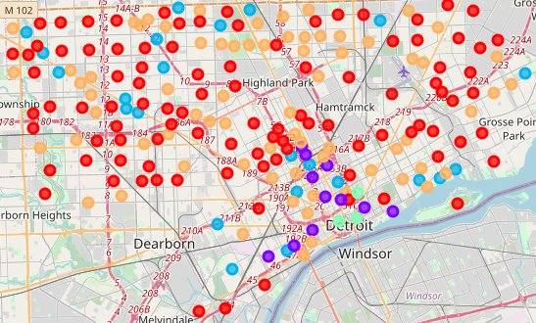
Segmenting Based on Number of Venues
Color | Avg Number of Venues
Green | 47
Purple | 23.1
Blue | 9.6
Orange | 5
Red | 1.7
Using K-means on the venue counts of each neighborhood, neighborhoods were assigned to one of 5 clusters.
Even this gross analysis produces distinct segments showing the concentration of venues located downtown.

Slide 5
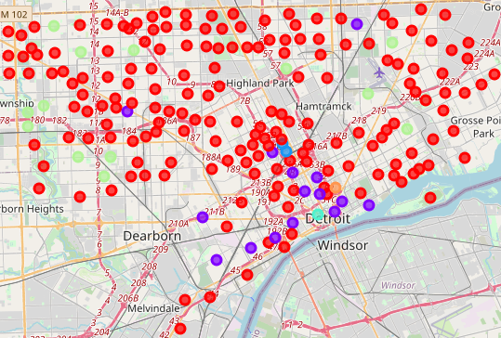
Segmenting Based on Count of Venue Types
Red
Venue Type | Average Venues per Cluster Neighborhood
Liquor Store | .18
Intersection | .13
Discount Store | .12
Blue
Venue Type | Average Venues per Cluster Neighborhood
Plaza | 1.5
Chinese Restaurant | 1
Hotel | 1
Light Blue/Downtown
Venue Type | Average Venues per Cluster Neighborhood
Coffee Shop | 7
Lounge | 5
Park | 4
Purple
Venue Type | Average Venues per Cluster Neighborhood
Pizza Place | .87
Bar | .87
American Restaurant | .8
Orange/Eastern Market
Venue Type | Average Number of Venues per Cluster Neighborhood
Farmers Market | 6
Coffee Shop | 3
Food | 2
The Tables show the three most frequent venue types and their frequency for each cluster. Light Green Clusters have no venues. This analysis shows an even more segmented city than the previous analysis.

Slide 6
Implications of the Data
The data shows that Detroit is a highly segmented city, with most venues being located in the downtown. While this is normal for many cities, it is notable that there is only one node of concentration for a very large city geographically (142.9 square miles).
It is also notable that areas which are not the downtown core and the immediate area surrounding it lack almost any venues whatsoever.
We can see it is likely that businesses and investment will continue to be concentrated downtown with areas immediately surrounding it likely to see more investment while the rest of the city sees relatively little.
Organizations concerned with Social Justice would likely wish to see a more even distribution of venues.

